Slide 1
Chapter 5
Using Running Records to Look at Social Development

Slide 2
Using Running Records (Slide 1 of 2)
Same writing technique as Anecdotal Records
Detailed account of what is observed: who, what, where, when
EXCEPT this is a sample or a specimen, so it is not an event but just an observation of 5–10 minutes of ordinary behavior with all details included

Slide 3
Using Running Records (Slide 2 of 2)
How to Find the Time
Using Technology
What to Do with It
File in child’s portfolio/folder
Use for planning and individualizing curriculum
Share with child and family
Use to document child’s normal (or unusual) behavior

Slide 4
Table 5-1: Method Recap
Advantages | Disadvantages
Is written at the time behavior occurs, so it is less likely to be affected by bias and more likely to include lots of detail | Make the subject feel watched, become uncomfortable, and change behavior, destroying the nature of the recording
Can be used for a variety of purposes-developmental assessment, deeper understanding of the child, information for other professionals for further analysis | Not show normally occurring behavior in the time segment
Details a normal segment of time in the day, giving a more natural view | Make the adult unavailable to facilitate or observe what is happening in the rest of the room because attention is focused on the recording
Reveals many areas of development in one recording | Tire and drain the recorder because of its intensity
Can evaluate the effectiveness of a learning center or area
Notes:
The Running Record
Records detailed segments of behavior occurring in a certain time block.
Focuses on an individual child to show a naturalistic view of a part of the day.
Can be analyzed for evaluation of many developmental areas: physical, social, emotional, language, self-concept, attention span, problem solving, memory, learning style.
Documents evaluation of developmental areas for child study.
Can focus on a particular learning center or classroom area to see what typically occurs there.

Slide 5
Looking at Social Development (Slide 1 of 3)
Play’s place in:
Social development
Social competence and school readiness
Skills learned in play help in school success
Play as the foundation of social studies
Self-identity
How other people live, think
Rules for harmonious interactions

Slide 6
Looking at Social Development (Slide 2 of 3)
Theories of Social Development
Freud
Erikson
Piaget
Skinner and Watson
Maslow
Vygotsky
Kohlberg

Slide 7
Looking at Social Development (Slide 3 of 3)
Implications of Social Learning Theory on Early Childhood Practices
Communication
Cooperation
Assertion
Responsibility
Empathy
Engagement
Self-control

Slide 8
The Importance of Play in Social Development (Slide 1 of 6)
Play is intrinsically motivated
Play is relatively free of externally imposed rules
Play is carried out as if the activity were real
Play focuses on the process rather than any product
Play is dominated by the players
Play requires the active involvement of the players

Slide 9
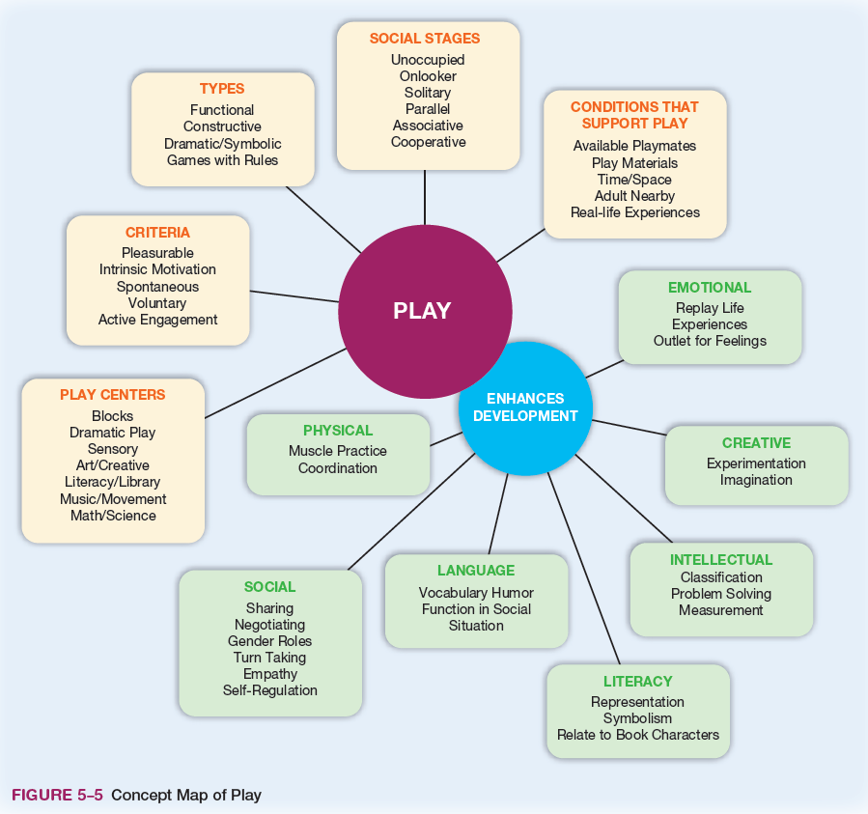
Figure 5-5: Concept Map of Play

Slide 10
The Importance of Play in Social Development (Slide 2 of 6)
Stages of Social Play
Negative Play or Nonplay (Unoccupied Play)
Onlooker Play
Solitary Play
Social Attention Play (Parallel Play)
Associate Play (Associative Play)
Collaborative Play (Cooperative Play)

Slide 11
The Importance of Play in Social Development (Slide 3 of 6)
Types of Cognitive Play
Functional Play
Constructive Play
Dramatic Play
Games with Rules

Slide 12
The Importance of Play in Social Development (Slide 4 of 6)
Social Competence and School Readiness
Confidence
Curiosity
Intentionality
Self-control
Relatedness
Capacity to communicate
Cooperativeness

Slide 13
The Importance of Play in Social Development (Slide 5 of 6)
Young Children and Social Studies
Culture
Time, continuity, and change
People, places, and environments
Individual development and identity
Individuals, groups, and institutions
Power, authority, and governance
Production, distribution, and consumption
Science, technology and society
Global connections
Civic ideals and practices

Slide 14
The Importance of Play in Social Development (Slide 6 of 6)
The Need for a Selfless Society
Socialization: process of learning social skills and personal identity
Self
Rooting reflex
Babkin reflex
Walking and stepping reflex
Moro reflex
Self-Gratification
Self-Assertion
Self-Initiator

Slide 15
Observing Social Development in Play (Slide 1 of 2)
Anecdotal and Running Records
Capture actions and words
Open method
Vivian Paley
Checklists
Penn Interactive Peer Play Scale
Play Skills Checklist
Play Observation Scale
Social Skills Improvement System

Slide 16
Observing Social Development in Play (Slide 2 of 2)
Observing Infants and Toddlers in Social Play
Early Friendships
Secure relationships with their mothers
Relationships with older siblings or children
Their mothers were friends
The children were at similar developmental levels, and had similar temperaments and behavioral styles

Slide 17
Helping All Children with Social Development
Children with Challenging Behavior
Disabilities and the Social Environment
Children with Autism
Culture and Social Interactions

