Slide 1
Chapter 6
Using Frequency Counts to Look at Emotional Development

Slide 2
Chapter 6 Learning Objectives
To describe the characteristics and uses of a Frequency Count.
To discuss the core emotions and how they are displayed at different developmental levels.
To generate strategies a teacher can use to provide an emotionally secure environment in a classroom or group.
To examine behaviors at various ages that give concern about emotional development.

Slide 3
Using Frequency Counts (Slide 1 of 2)
Recording method to measure how often a specified event occurs
Closed method—No details recorded
Measure the outcomes after implementing a strategy
Used to document frequently occurring behaviors
Used to measure prosocial and antisocial behavior

Slide 4
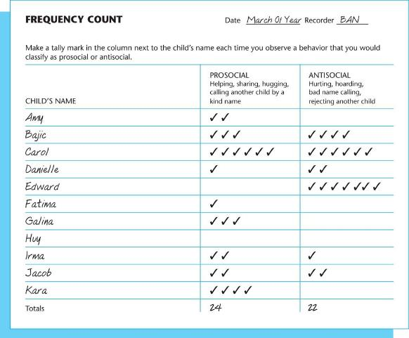
Figure 6-2: Frequency Count Example

Slide 5
Table 6-1: Method Recap
Advantages | Disadvantages
A quantitative measurement on which to base strategies for change | Lose the raw data, with no details recorded
Quick to record, with no details, just tallies to write | Only measure one kind of behavior, making the results highly selective
Useful for quantitatively and objectively measuring frequently occurring behaviors | Allow the recorder’s bias to enter the recording
Notes:
Frequency counts are used to measure frequently occurring behaviors.

Slide 6
Using Frequency Counts (Slide 2 of 2)
How to Find the Time
Using Technology
What to Do with It
If it is focused on a child, it can measure the effects of an intervention strategy
It can be filed in the child’s folder
If it is on the whole group it can be a pre- and post-measurement of an intervention strategy, filed in the Class File rather than individual folders
Shared with child, family, group as appropriate

Slide 7
Looking at Emotional Development (Slide 1 of 4)
Temperament
Activity level
Rhythmicity
Approach or withdrawal
Adaptability
Intensity of reaction
Threshold of responsiveness
Quality of mood
Distractibility
Attention span and persistence

Slide 8
Looking at Emotional Development (Slide 2 of 4)
Socialization of Emotional Responses
Emotional intelligence: type of intelligence that controls emotions in a socially acceptable way
Core Emotions
Basic emotions present at birth from which other emotions evolve
Joy, Love, Happiness
Children under Stress
The Resilient Child
Anger and Aggression

Slide 9
Looking at Emotional Development (Slide 3 of 4)
Joy, Love, Happiness
Children under Stress
The Resilient Child
Anger and Aggression
Accidental
Expressive
Instrumental
Hostile
Fear
Shyness, a Form of Fear
Sadness and Shame

Slide 10
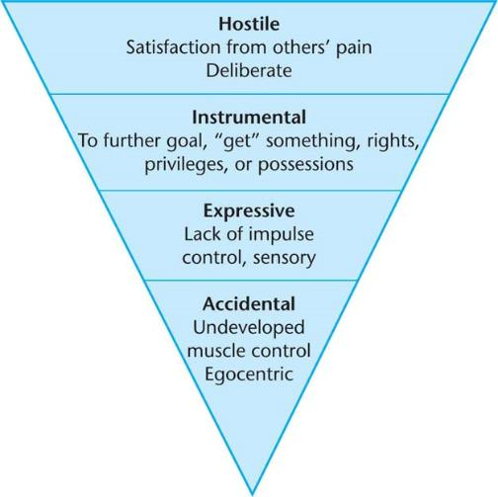
Figure 6-7: Types Of Aggression

Slide 11
Looking at Emotional Development (Slide 4 of 4)
The Development of Conscience
Conscience: internal voice that guides moral actions
Empathy: intellectual and emotional response to another person’s discomfort
The Absence of Joy
Failure to Thrive Syndrome: developmental delays caused by physical or emotional factors

Slide 12
Helping Children with Emotional Expression (Slide 1 of 3)
The Emotionally Secure Environment
Executive Function
Modeling
Direct instruction
Positive or negative reinforcement

Slide 13
Helping Children with Emotional Expression (Slide 2 of 3)
Challenging Behavior
“Behavior that interferes with learning or social engagement”
Intervention begins with assessment based on typical developmental behavior
Prevention of more serious social problems later
Bullying – Anti-social, coercive behavior that sets a pattern of aggression

Slide 14
Helping Children with Emotional Expression (Slide 3 of 3)
Behaviors that Warrant Concern for Emotional Development
Infants and Toddlers
Preschoolers
Young School-Agers
What works?

Slide 15
Helping All Children with Emotional Development: Infants and Toddlers (Slide 1 of 2)
Watch for behavior that gives clues to:
Sensory integration – Organization of sensory information dependent on temperament and the duration and intensity of stimuli
Self-regulation – Ability to control reactions to stimuli and behavior
Watch for arousal, attention, affect ,and action

Slide 16
Helping All Children with Emotional Development: Infants and Toddlers (Slide 2 of 2)
Emotional Development of Dual Language Learners
Emotional Development of Children with Disabilities

