Slide 1
Chapter 7
Using Conversations to Listen to Language and Speech

Slide 2
Chapter 7 Learning Objectives
To discuss how to observe children’s language and speech through conversations
To explain the differences between speech, receptive and expressive language
To review the progress of language development
To give examples of the teacher’s role in language development
To examine the ways the teacher can help all children with language development

Slide 3
Using Conversations to Listen to Language and Speech (Slide 1 of 3)
Listening as the Foundation for Language Development
Planned listening activities
Do something for themselves
Tell another how to do something
Operate some type of toy or equipment
Carry a message
Recall details
Put objects in a special order or sequence
See how many or facts they can remember
Learn new skills

Slide 4
Using Conversations to Listen to Language and Speech (Slide 2 of 3)
Informal Observations of Language
Listening to Language Play
Environments for Conversation
Child Interviews
Scheduled Interviews
Diagnostic Interviews
Facilitated Conversations
Observing during Dialogic Reading

Slide 5
Using Conversations to Listen to Language and Speech (Slide 3 of 3)
Documenting Children’s Language
Voice Recording Children’s Language Development
Confidentiality Issue
How to Find the Time
Using Technology
What to Do with It
Notes or tape recordings can be filed in the child’s portfolio/folder
Use interests and knowledge revealed to build curriculum

Slide 6
Table 7-1: Method Recap
Advantages | Disadvantages
Reveal the child’s prior knowledge about the world to help plan meaningful learning experiences | Time intensive when focusing on one child
Help the child organize her thinking, talking it through, externalizing the internal thinking | Intimidating, so the child may be reluctant to speak under certain circumstances
Yield multitudes of information both in content and in language production from natural situations | Intrusive and may appear to probe into confidential areas
Can be analyzed later
Show progress of speech and language over time
Raise a child’s self-esteem as the focus of a one-on-one conversation, with a closely attentive listener
Notes:
Conversations and interviews method of recording can be used for assessing the child’s language, cognitive, and social-emotional development.

Slide 7
Listening to Speech (Slide 1 of 2)
Receptive Language: Listening
Learning to Listen
Appreciative listening
Purposeful listening
Discriminative listening
Creative listening
Critical listening

Slide 8
Listening to Speech (Slide 2 of 2)
Speech
Language
Phonemes
Morphemes
Articulation
Expressive Language
Stuttering

Slide 9
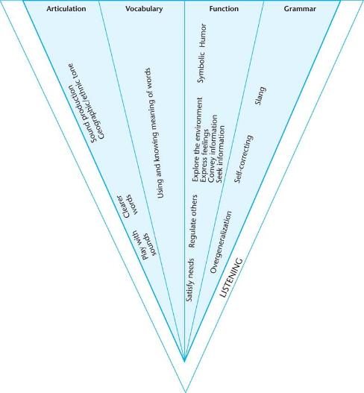
Figure 7-1: Speech and Language Development

Slide 10
Language Development (Slide 1 of 4)
Phonology
Vocabulary
Grammar
Discourse
Pragmatics

Slide 11
Language Development (Slide 2 of 4)
Language Acquisition Theories
Skinner and Bandura
Chomsky
Bruner
Vygotsky
Hart and Risley

Slide 12
Language Development (Slide 3 of 4)
Language Progression
Beginning Communication
Holographic phrases
Telegraphic phrases
Syntax
overgeneralization

Slide 13
Language Development (Slide 4 of 4)
Functions of Language
Greetings, informing, demanding, promising, requesting
Needs of the listener
Following roles for conversations
Social and Nonverbal
Dual Language Learners

Slide 14
The Teacher’s Role in Language Development (Slide 1 of 3)
Facilitating Language
Elicited Conversations
“Teacher, Be Quiet”

Slide 15
The Teacher’s Role in Language Development (Slide 2 of 3)
Language Role Models
The Tester
The Helper
“Use Your Words”
“How Would You Like It if She Did That to You?”
Incorrect Grammar, Slang, and Lazy Articulation
Tone and Volume

Slide 16
The Teacher’s Role in Language Development (Slide 3 of 3)
Language and Literacy Connection
Language and the Common Core

Slide 17
Helping All Children with Language Development
Observing the Developing Language of Infants and Toddlers
Dual Language Learners
The Quiet Child
Children with Differing Abilities in Regular Classrooms

