Slide 1
Chapter 10
Using Rating Scales to Look at Literacy

Slide 2
Using the Rating Scales (Slide 1 of 2)
Rating scale: method of measuring a specific behavior, skill or attribute along a continuum
Quality point: milestones or measurement intervals on a rating scale
Interrater reliability: two or more raters use the same instrument to control bias
Selective method: the recording instrument dictates what is to be observed and recorded

Slide 3
Using the Rating Scales (Slide 2 of 2)
Rating Scale Examples
The Work Sampling System, 5e
NAEYC’s Center Accreditation Self-Study
Early Learning Observation and Rating Scale
Teaching Strategies GOLD
The Environment Rating Scale (ECERS-3)
How to Find the Time
Using Technology
What to Do with It

Slide 4
Table 10-1: Method Recap
Advantages | Disadvantages
Fast and convenient | Not backed up with raw data
Efficient for measuring a large number of criteria quickly | Not objective
Informative of what “should be” expected | Not free of rater bias, with no way for the reader to know that
Useful for tracking progress or a warning or developmental lags | Not useful as a method to record spontaneous actions or conversations
An assessment measurement against the ideal and used as a plan for improvement | Not sensitive to a wide range of individual differences
Revisited to see progress over time
Notes:
The Rating Scale measures the range of progress of a specific criterion of development. It may result in a numerical value, a graph or bar chart, or a scatter diagram. When revisited, it can be used to chart progress, indicate delays, or advanced development.

Slide 5
Looking at Literacy (Slide 1 of 5)
Phase 1: Awareness and exploration
Phase 2: Experimental reading and writing
Phase 3: Early reading and writing
Phase 4: Transitional reading and writing
Phase 5: Independent and productive reading and writing

Slide 6
Looking at Literacy (Slide 2 of 5)
https://youtu.be/XmQJ1NFWn5g
Importance of Literacy
Print-rich environment—Reading opportunities are all around
Emergent literacy—Everyday experiences
Babies and books—Early is good
Reading to preschoolers—Involves all areas of development

Slide 7
Looking at Literacy (Slide 3 of 5)
Literacy-Rich Environment
Environmental Print: signs and labels that appear on everyday objects
Contextualized Literacy: ability to read words when other clues are present

Slide 8
Looking at Literacy (Slide 4 of 5)
The Play-Literacy Connection
Play provides opportunities to promote literacy skills
Language experiences in play build between oral and written communication
Opportunities to use literacy in real-life ways
Play/Literacy impacts and is impacted by all domains of development
Play themes with literacy are opportunities for social emotional expression

Slide 9
Looking at Literacy (Slide 5 of 5)
Literacy in the Digital Age
Literacy and Computers
Electronic Books

Slide 10
Learning to Read (Slide 1 of 2)
Elements of Learning to Read
Concepts of Print
Alphabetical Knowledge
Phonological Awareness
Vocabulary
Reading Fluency

Slide 11
Learning to Read (Slide 2 of 2)
Approaches to Teaching Reading
Reading to Inspire the Love of Reading
Reading in the Early Grades
Common Core State Standards for Literacy

Slide 12
Learning to Write
Stages of Writing
Scribbling
Drawing
Making Letters
Name Writing
Organizing Print
Writing to Read
Journal Writing
Conventional Writing

Slide 13
Literacy Assessment
Observing Literacy Development in Infants, Toddlers, and Preschoolers
Giving listening and visual attention to book
Sensory experiences of touching, smelling, and tasting
Lengthening memory and attention span
Re-telling story from pictures
Giving attention to the printed words on the page

Slide 14
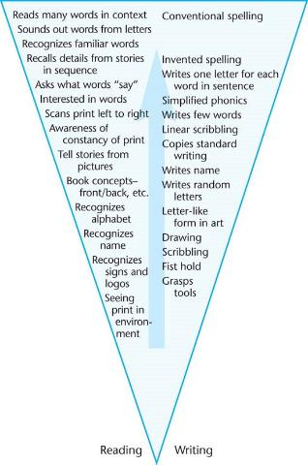
Figure 10-8: Reading and Writing Development

Slide 15
Helping All Children with Literacy
Physical Disabilities and Literacy
Learning Disabilities and Literacy
Literacy and Children Who Are Dual-Language Learners

