Slide 1
Chapter 11
Using Work Samples to
Look at Creativity

Slide 2
Using Work Samples to Observe a Child’s Development (Slide 1 of 3)
Work Samples: method that preserves the child’s work as documentation of development
Media: art materials
Portfolios
Part of assessment plan

Slide 3
Using Work Samples to Observe a Child’s Development (Slide 2 of 3)
Work Samples to Document Development
Amplifies developmental checklists
Mirrors and augments other recording methods
Includes conversations with the child
Includes a wide variety of materials

Slide 4
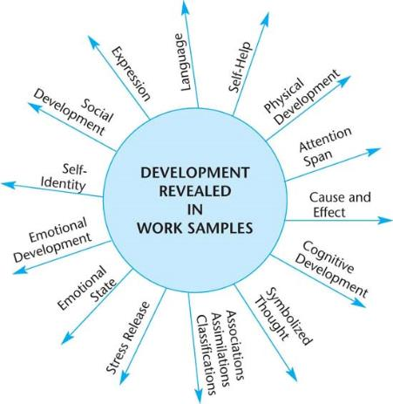
Figure 11-1: Development Revealed in Work Samples

Slide 5
Using Work Samples to Observe a Child’s Development (slide 3 of 3)
Collaborating with Colleagues About the Significance of Work Samples
How to Find the Time
Using Technology
What to Do with It
Depending on medium, it can be duplicated for child’s portfolio
Shared with child and family as a point of discussion and comparison to work over time
Displayed in classroom (without competition)
Used to explore children’s interests and extend with planned activities

Slide 6
Table 11-1: Method Recap
Advantages | Disadvantages
In a natural classroom setting, with the child selecting materials and working at her pace and direction, illustrating many areas of development | Make the child overly conscious of manipulation or practice
Over a period of time showing progress of development | Lead the observer to draw erroneous conclusions from the work
As an expression of the child’s thoughts and feelings more accurately and powerfully than an observer can describe them | Reflects the inferences of the selector, as the teacher may only gather scribbling or experimental pieces when actually the child does mush more advanced work
Notes:
Work Samples are selected pieces of a child’s products that my be artistic, written, three-dimensional models (photographed).

Slide 7
Looking at Children’s Creative Development (Slide 1 of 2)
Observing children’s creative effort can indicate the following:
Long attention span
Capacity for organization
Seeing things in a different perspective
Exploring before formal instruction
Using solitary time
Taking a “closer look” at things
Creativity
Storytelling and song making

Slide 8
Looking at Children’s Creative Development (Slide 2 of 2)
Creativity and Cognitive Development
Time
Previous experience
Art stages parallel Piaget and Erikson
Benefits of Creativity
Reggio Emilia and Children’s Literacies
Representation of the Project Approach
Assessing Creative Program Goals

Slide 9
Children Drawing (Slide 1 of 3)
Stages of Children’s Drawing
Stage 1: Mark-Making
Stage II: Scribbling Stage
Stage III: Preschematic Stage
Stage IV: Schematic Stage

Slide 10
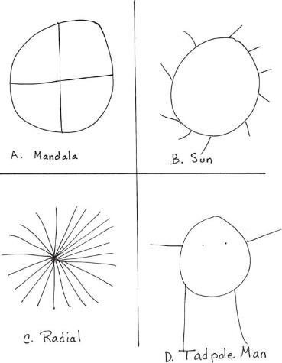
Figure 11-1: Early Stages of Drawing

Slide 11
Children Drawing (Slide 2 of 3)
Talking with Children About Their Creative Work
Complimentary
Judgmental
Valuing
Questioning
Probing
Correcting
Psychoanalyzing
Modeling
Describing

Slide 12
Children Drawing (Slide 3 of 3)
Using Self-Portraits to Know the Child
Observing Creativity in Infants and Toddlers
Learning how to create something from “raw” materials
Exploring materials with their senses
Learning different ways to express thoughts and ideas
Learning to make decisions
Developing the ability to share materials and appreciate others’ work
Developing a positive self-concept
Developing and refining fine motor and cognitive activities

Slide 13
Other Creative Media (Slide 1 of 2)
Music and Movement Development
Sensory Experiences
Blocks as a Creative Medium
Stages in Block Play
Stage I: Carrying, Filling, and Dumping
Stage II: Beginning Block Building
Stage III: Bridging
Stage IV: Enclosures
Stage V: Patterns
Stage VI: Naming Structures
Stage VII: Reproducing True-Life Structures
Use of Block Play

Slide 14
Other Creative Media (Slide 2 of 2)
Using Technology Creatively
Computers
Smart phones
DCD and CD players
Digital cameras
All kinds of handheld devices

Slide 15
Helping All Children with Creativity
Giftedness: Creative and Cognitive Development beyond Expected Levels
Cultural Diversity
Ability Diversity

