Slide 1
Chapter 12
Using Technology for Documentation of Dramatic Play

Slide 2
Using Technology for Documentation (Slide 1 of 3)
Types of Technological Media for Observing and Recording
Photography
Audio Recording
Video
Computers and Scanners

Slide 3
Using Technology for Documentation (Slide 2 of 3)
Ethical Use of Technology Documentation
Obtain informed consent
Maintain confidentiality
Obtain prior permission
Media as Documentation for Other Areas of Development

Slide 4
Using Technology for Documentation (Slide 3 of 3)
How to Find the Time
What to Do with It
Individual works can be stored in each child’s folder or on a computer disc
Display—Documentation panels showing process or evolution of a project
Share with child and family
Use as emergent curriculum

Slide 5
Table 12-1: Method Recap
Advantages | Disadvantages
Captures visual or real sound images of the episode | Expensive
Is less subject to the recorder’s bias or inferences | Complicated and time-consuming
Allows the viewer to form judgments independent from the recorder’s | Intrusive to children and teachers
Can be analyzed in a number of ways, for different purposes, at different times | A factor causing unnatural behavior
Can be stored efficiently, especially if they are digital | May be against family values
Notes:
Uses: Audio/visual recordings to document, share and archive children’s development

Slide 6
Looking at Dramatic Play (Slide 1 of 4)
Mastery Play
Innovative Play
Kinship Play
Therapeutic Play

Slide 7
Looking at Dramatic Play (Slide 2 of 4)
Dramatic Play at Various Ages
Infancy
Young Toddlers
Older Toddlers
Preschoolers
Young School-Agers

Slide 8
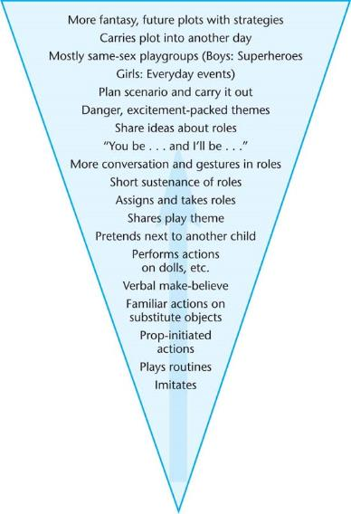
Figure 12-4: Dramatic Play Development

Slide 9
Looking at Dramatic Play (Slide 3 of 4)
Types of Dramatic Play
Sociodramatic
Teacher-guided creative dramatics
Story dictation

Slide 10
Looking at Dramatic Play (Slide 4 of 4)
Play Stages in Dramatic Play
Onlooker
Solitary Dramatic Play
Parallel Dramatic Play
Associative Dramatic Play
Cooperative Dramatic Play

Slide 11
Dramatic Play and Development (Slide 1 of 2)
Developmental Domains Observed in Dramatic Play
Creative
Intellectual
Emotional
Social
Language and Literacy
Executive Function
Physical

Slide 12
Dramatic Play and Development (Slide 2 of 2)
The Role of the Teacher in Dramatic Play
Setting the environment
Role playing conflict resolution
Predetermined scenarios
Other Methods for Observing Dramatic Play
Anecdotal Recordings
Class List Log
Time Samples
Developmental Checklist
Rating Scales

Slide 13
Helping All Children with Dramatic Play
Cultural Differences in Dramatic Play
Socioeconomic Differences in Dramatic Play
Differing Abilities and Dramatic Play

