Slide 1
Chapter 13
Using Documentation for Child Abuse Suspicions and Looking at Self-Concept

Slide 2
Using Documentation for Child Abuse Suspicions (Slide 1 of 8)
Neglect: withholding of basic survival needs
Physical Abuse: any nonaccidental physical injury
Sexual Abuse: sexually explicit conduct with a minor
Emotional Maltreatment: psychological damage from blaming, belittling, or rejecting
Mandated reporters: individuals who by law must report suspicions of child abuse to specified agencies
The Abusers

Slide 3
Using Documentation for Child Abuse Suspicions (Slide 2 of 8)
Responsibilities of Early Childhood Professionals to Prevent Child Abuse
Early childhood programs should employ an adequate number of qualified staff to work with children and to provide adequate supervision of program staff and volunteers
The program environment should be designed to reduce the possibility of private, hidden locations in which abuse may occur
All program staff, substitutes, and volunteers should receive preservice orientation and refresher training at regular intervals

Slide 4
Using Documentation for Child Abuse Suspicions (Slide 3 of 8)
Responsibilities of Early Childhood Professionals to Prevent Child Abuse, cont.
Centers, schools, and homes should have clear policies and procedures for maintaining a safe, secure environment
Teachers and caregivers should be supervised by qualified personnel on an ongoing basis, and parents should be encouraged to spend time in the program
Programs should not institute “no-touch policies” to reduce the risk of abuse

Slide 5
Using Documentation for Child Abuse Suspicions (Slide 4 of 8)
Physical and Behavioral Indicators of Abuse
Reasonable Cause to Suspect
The Childs Appearance
Behavior Indicators
The Child’s Description or Disclosure
Circumstantial Evidence

Slide 6
Using Documentation for Child Abuse Suspicions (Slide 5 of 8)
Teachers as Reporters
Teachers are more likely to report physical abuse than emotional abuse or neglect
Teachers tend to delay reporting until they feel they have sufficient evidence
Boys are more frequently the subject of substantiated abuse
Lower socioeconomic groups are more likely to be reported
The quality of the relationship with the child and family influenced the willingness to report
Male teachers are less tolerant of abuse and neglect, and report more frequently

Slide 7
Using Documentation for Child Abuse Suspicions (Slide 6 of 8)
Teachers as Reporters, cont.
Experienced teachers are more likely to report
Teachers’ knowledge of indicators and reporting procedures were often inadequate
Fear of the negative consequences may prevent or delay reporting
The role of the school principal is influential in reporting or not
Teacher Support

Slide 8
Using Documentation for Child Abuse Suspicions (Slide 7 of 8)
Recording Any Indicators of Maltreatment
Anecdotal Record
Next Steps
Legal Process of Reporting
When the Hotline or Law Enforcement Agency Is Called
Do Not Discuss Suspicions with the Family or the Child

Slide 9
Using Documentation for Child Abuse Suspicions (Slide 8 of 8)
Diversity and Child Abuse
Cultural Differences
Different Abilities
What to Do with It
Notes: Anecdotal recordings, once acted upon, should be filed according to program policies – usually in a confidential file with the administrator
Report: An official report (see Figure 12-4) is filled out and filed; a copy should be kept along with the notes above in the confidential file
Using Technology

Slide 10
Table 13-1: Method Recap
Advantages | Disadvantages
Protects the child from possible further harm if the suspicions are founded | Is traumatic situation in the life of a teacher/caregiver
Knowledgeable officials investigate and make determinations as to whether the suspicions are founded | May possibly be that suspicions are circumstantial
Connects the family with assistance if the suspicions are founded | Raises fear of reprisal by the family
Notes:
As mandated reporters teachers must document and report suspected child abuse or maltreatment.

Slide 11
Looking at Self-Concept
Development of Self-Concept
The First Year
The Second Year
Older Preschoolers
Early School-Agers

Slide 12
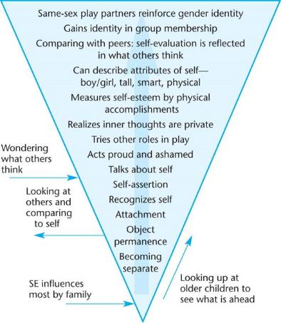
Figure 13-8: Self-Concept Development

Slide 13
Looking at Self-Esteem
The Origins of Self-Esteem
Self-Esteem High/Low, Helpful or Not?
Families and Schools That Build Self-Esteem
Sex-Role Identity and Self-Esteem
Racial/Ethnic Identity and Self-Esteem
Independence or Interdependence?

Slide 14
Observing Self-Concept and Self-Esteem
Self-Esteem Revealed in Developmental Domains
Separation
Self-Care
Physical
Social
Emotional
Speech and Language
Memory and Attention Span
Cognitive
Creativity
Literacy
Adjustment to a New Setting

Slide 15
Helping All Children with Self-Esteem
Culture, Race, and Self-Esteem
Disabilities and Self-Esteem
Child Maltreatment and Self-Esteem

