Slide 1
Chapter 2
Using the Class List Log to Look at Separation and School Adjustment

Slide 2
Chapter 2 Learning Objectives
To identify the characteristics of the Class List Logs as an observational tool.
To describe the Reflective Journal and its value.
To explain plans to help children and families adjust to school or groups.
To identify warning signs of separation difficulties.
To examine strategies to include all children in school adjustment.

Slide 3
Using the Class List Log (slide 1 of 3)
Method or format to record one or more short, important-to-know pieces of information about each child present on that day.
Used for intentional teaching

Slide 4
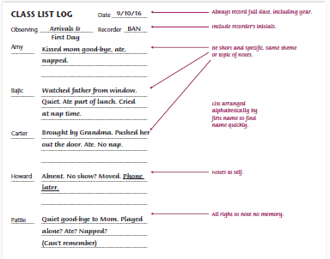
Figure 2-1: Class List Log Example

Slide 5
Table 2-1: Method Recap
The Class List Log is useful to make notes on many different pieces of information, but each Class list Log is for one specific behavior skill for all the children.
Advantages | Disadvantages
Is quick and easy | The form becomes outdated as children enter or leave the group
Records specific information on every child in the group | Rewriting is time consuming
Gives specific, dated, brief, factual information | Limited information or data is recorded
Can be transferred to other forms of recording as base information | It must be repeated to be valuable for comparison
Can be used later for comparison | It is not useful for unusual events for which details are important to remember

Slide 6
Using the Class List Log (Slide 2 of 3)
Uses
Separation from family
Large or small muscle
Language or literacy
Math, science, art, blocks, or dramatic play
How to Find the Time
Using Tools and Technology
Clipboards
Index cards
Mailing labels
Date stamp
Tablet or smart phone

Slide 7
Using the Class List Log (Slide 3 of 3)
What to Do With This Information
Filed in the child’s folder
Copied and put in each child’s folder
Transferred to a checklist
Shared with the family
Objective, not subjective

Slide 8
Using the Reflective Journal (Slide 1 of 3)
Reflective journal is a place for recording personal thoughts
Like a diary
Not documentation on children to assess development

Slide 9
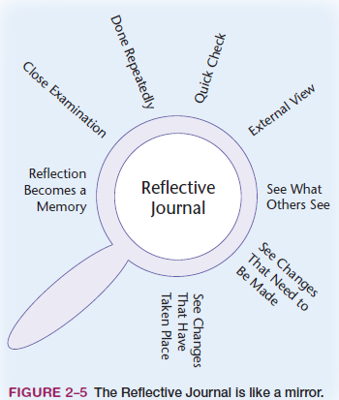
Using the Reflective Journal (Slide 2 of 3)
External view
Quick check
See changes
Close examination
Make changes
Done repeatedly
Reflection becomes a memory
Notes:
Figure 2-5: The Reflective Journal is like a mirror.

Slide 10
Using the Reflective Journal (Slide 3 of 3)
Home Visitation Programs
How to Find the Time
Using Technology
What to Do with the Reflective Journal
Kept secure and private
Used as an emotional release
Used to measure professional development
Used to explore questions
Reviewed at intervals

Slide 11
Looking at Separation and School Adjustment (Slide 1 of 2)
Attachment
Stranger anxiety
Separation anxiety
Good-bye rituals

Slide 12
Looking at Separation and School Adjustment (Slide 2 of 2)
Preparation for Entering Programs or School
Information Gathering Prior to the First Day
Personal Meetings
Visit to the Home
Visit to the Program or School
Formal Family Orientation
Transitions for Infants
Working with Families for Arrivals and Departures
Primary School Arrivals and Departures

Slide 13
Helping All Children with School Adjustment (Slide 1 of 2)
Separation Anxiety and Difficulties
Separation Anxiety Warning Signs
Eating
Sleeping
Toileting
Participation
Social interactions
Acting out
Permanent Departures and Good-Byes

Slide 14
Including All Children with School Adjustment (Slide 2 of 2)
Children with Special Needs
IFSP
IEP
Least restrictive environment
Diverse Cultures
Culturally competent
Dual-language learner (DLL)

