Slide 1
Week by Week: Plans for Documenting Children’s Development
Chapter 1
Getting Started

Slide 2
Chapter Learning Objectives
To understand why teachers should observe their students
To identify why it is important to write down (document observations
To discuss why it is useful to use different methods to observe and what role you play as an observer.

Slide 3
Defining Observe (Observation)
Observe –
1. The action or process of observing something or someone carefully or in order to gain information.
2. A remark, statement, or command based on something one has seen, heard, or noticed.

Slide 4
Why Observe?
Safety
Physical Health
Know the Child
Assistance
Curriculum Planning to Extend Learning
Communication with the Child
Communication with the Family
Guidance
Measure Progress, Assessment, Evaluation
Referral
Self-Reflection
Accountability

Slide 5
Why Write It Down?
Remember
Compare
Amplify Later
Catch and Preserve Details
Serve as a Literacy Role Model
Document

Slide 6
Why, When, and Who (Slide 1 of 1)
Why Use Different Observation Methods?
Types of Recording Methods
Narrative
Criterion-referenced
Quantitative
Work samples
When to Observe?
Natural setting
While children are engaged in play

Slide 7
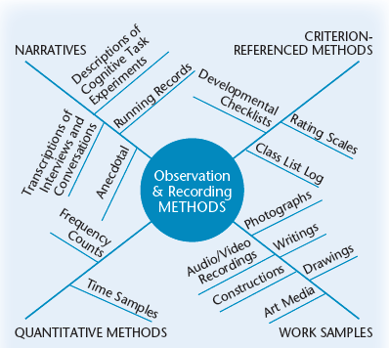
Figure 1-6 Methods Web

Slide 8
Why, When, and Who (Slide 2 of 2)
What are the Roles of the Observer?
Participant Observer
Teacher
Student teacher
Home visitor
Non-Participant Observer
Student
Visiting teacher
Family member
Other professionals

Slide 9
Building Child Development Portfolios
What Is Child Development?
Development – change that takes place in a predictable sequence, from simple to complex, but in a different pace for individual people
Why Use Portfolio Assessment?
Utility, acceptability, authenticity, equity, sensitivity, convergence, collaboration, congruence

