Slide 1
Chapter 3
Using Anecdotal Recordings to
Look at Self-Care

Slide 2
Chapter 3 Learning Objectives
To describe the characteristics of an anecdotal recording.
To distinguish between a narrative account and in inference.
To identify the developmental progression of self-care skills.
To determine strategies the teacher can use to help all children with self-care skills.

Slide 3
Using the Anecdotal Recording
Detailed, factual account of what the recorder sees and hears; best if it’s written immediately after the incident
Narrative: when, where, who, and what happened and the result
Open Method: preserves details
What to Write About: finding an interest, being involved, persisting with difficulty, expressing an idea or point of view, taking responsibility
Learning Stories

Slide 4
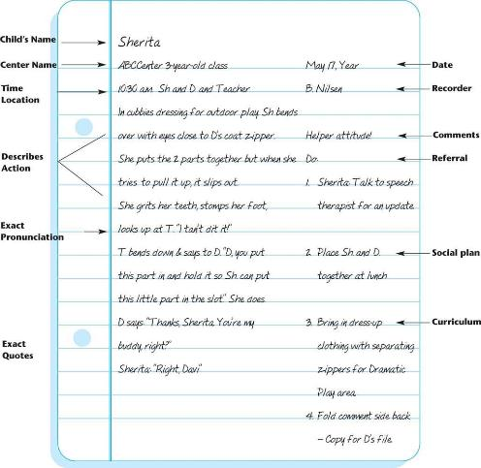
Anecdotal Record

Slide 5
Table 3-1: Method Recap
Advantages | Disadvantages
Need no special forms | Choosing which incidents to record gives the writer selectivity that may influence positive or negative collections
Are preserved facts and details from which any reader may draw conclusions | Intense writing is necessary to capture all the details, quotes, and body movements
Give a short, contextual account of an incident | Focusing on writing diverts attention from interactions with children
Give the reader a “sense of being there” | The Anecdotal Recording can only focus on a few minutes of action
Separate judgments or inferences from the details of the incident | The Anecdotal Recording can only focus on one or two children at a time
Are useful for recording all areas of development
Are necessary for capturing exact details for specific purposes such as speech/language development and child abuse disclosure
Notes:
The Anecdotal Recording method can be
used for preserving details about an developmental skill, behavior, or incident for later judgments and reflection.
given to other people for their independent evaluations.
used as an accurate, detailed recording method in suspicion or disclosure of child abuse.

Slide 6
Keeping Inferences Out of Anecdotal Recording (Slide 1 of 3)
Inference: conclusion, judgment, explanation
The Language of Observation
Verbs
Adverbs
Adjectives
Tense
Sequence
Observer bias

Slide 7
Keeping Inferences Out of Anecdotal Recording (Slide 2 of 3)
Anecdotal Differs from Diary
Diary: summarizes actions, draws conclusions, leaves out helpful information
Anecdotal record: gives enough detail so that the readers has the feeling of being there, “sees” and “hears”
How to Find the Time
Audio Recording
Video Recording
Voice-to-Text Software
Text on a Smart Phone

Slide 8
Keeping Inferences Out of Anecdotal Recording (Slide 3 of 3)
What to Do with This Information
Child’s Portfolio
Intentional Teaching
Other Teachers on the Team
Sharing with Families
Conferring with Helping Professionals
Talking with the Child
Evidence to Child Protective Services

Slide 9
Looking at Self-Care Skills (Slide 1 of 4)
Development of Self-Care Skills
Self-Care and Autonomy
When to Help and When Not To

Slide 10
Looking at Self-Care Skills (Slide 2 of 4)
Observing Self-Care Skills
Eating
Toileting
Role Models
Direct Instruction
Dressing
Personal Hygiene
Sleeping
Environment

Slide 11
Looking at Self-Care Skills (Slide 3 of 4)
Self-Care Skills and Intentional Teaching
Appropriate expectations for the task, age, and individual child’s abilities
Appropriate sizes of furniture
Clear expressions of expectations to the child

Slide 12
Looking at Self-Care Skills (Slide 4 of 4)
Helping All Children with Self-Care Skills
Culture and Eating
Other Cultures and Independence
Culture and Toilet Training
Culture and Sleeping
Children with Special Needs

Slide 13
Anecdotal Recording Practice
Henry at mealtime
https://vimeo.com/130569444

